Slide 1


DISINFECTION
Basic Wastewater
Southeast Section Workshop
August 12-13, 2026
Roswell Convention Center
912 North Main St.
Roswell NM 88201

Slide 2
AMY NORTHAM, PA, CPM
TWUA Instructor
Lab Director & Operations Supervisor – Village of Ruidoso
Director of Wastewater – Levelland, TX
Lab Tech, Operations, & Shift Leader – Lubbock, TX
NM Level IV Wastewater License
NM Level III Lab License
TX Level A Wastewater License
(806) 535-5414 cell
AmyN@wuci-sw.com
https://wuci-sw.com/

Slide 3

QR Code to download pdf handout for slides and practice exam.

Slide 4
Disinfection
All wastewaters contain microorganisms or microbes
Some are beneficial and needed for natural processing of the wastewater
Others, called pathogens, are harmful and need to be removed or sterilized because they cause diseases
Sterilization of the water causes ALL microorganisms to die
Disinfection destroys or neutralizes the pathogens that cause the disease
Wastewater discharges must be disinfected to protect:
  Public Water Supplies
  Recreational & Reuse receiving waters
  Aquatic and other wildlife

Slide 5
Disinfection
Pathogens enter the system through people who have the diseases
  Why wastewater was used to track COVID
Three major categories of water-borne pathogens:
  Bacteria
    Cholera, Shigella, Salmonella, Typhoid, Dysentery, Meningitis
  Viruses
    Hepatitis, Polio, Norwalk, Rotavirus, Adenovirus, COVID
  Protozoa
    Giardia lamblia, Cryptosporidium parvum
Disinfection is one of the primary goals for wastewater treatment
Several methods are used
  Chlorine (Cl₂), UV, Ozone (O₃), Chlorine Dioxide (ClO₂)
Chlorine and UV are two most common disinfection methods in US

Slide 6
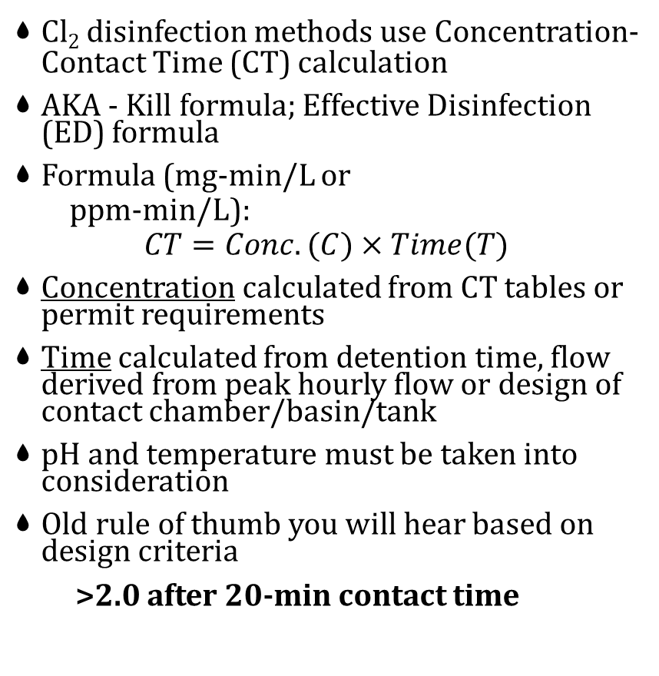
Disinfection
Cl₂ disinfection methods use Concentration-Contact Time (CT) calculation
AKA - Kill formula; Effective Disinfection (ED) formula
Formula (mg-min/L or
  ppm-min/L):
$$CT=Conc.(C)×Time(T)$$
Concentration calculated from CT tables or permit requirements
Time calculated from detention time, flow derived from peak hourly flow or design of contact chamber/basin/tank
pH and temperature must be taken into consideration
Old rule of thumb you will hear based on design criteria
  >2.0 after 20-min contact time
EPA provides CT tables according to log inactivation to determine required contact time for permitting.
  These tables and log values are used in advanced wastewater and drinking water classes.
New Mexico does not specify a fixed detention time in NMAC 20.7.4 or 20.6.2. NM permits specify:
  CT must be sufficient to meet fecal coliform limits
  CT must be calculated using peak hour flow
  CT must be based on the disinfection method used
  CT must be demonstrated through design documents
  NM follows the EPA CT concept, not a fixed minute rule

Slide 7
Chlorine

Slide 8
Chlorine
Most widely used because pathogens are most sensitive to its effects and readily available
Comes in different forms:
  Gas - cheapest per pound
  Powder, granules, tablets
  Liquid - (Bleach) most expensive
Requires safety equipment & precautions as a hazard assessment
Requires dechlorination before discharged into waterways
Hazards
  Corrosive
  Oxidizer
  Toxic
Used for:
  Disinfection
  BOD removal
  Grease removal
  Odor control
  Trickling Filters (flies)
  Sludge bulking
  Algae control in weirs

Slide 9
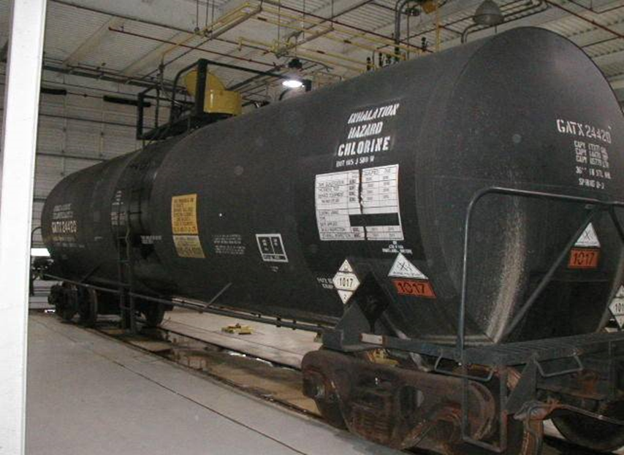
Chlorine Gas
Gas (pure Chlorine, Cl₂)
  Rail Car
  1 Ton cylinders
  150 lb cylinders
Properties:
  1 ½ times heavier than Water
  2 ½ times heavier than Air - LDL 0.1%
  Non-flammable
  Greenish yellow gas
  Pungent odor
  Irritant - PEL = 1 ppm; IDLH 10 ppm
  Corrosive - forms HCl with moisture in air
Leaks can be detected using concentrated ammonia (white vapor reaction)
Cheapest but more hazardous
Gas is compressed while filling the cylinder, which turns into a liquid inside the cylinder. 15% gas, 85% liquid
Vaporizes at room temperature
Will freeze if drawn off too quickly
Only way to accurately measure it, is by weight
Notes:
LDL = lower detection limit

Slide 10
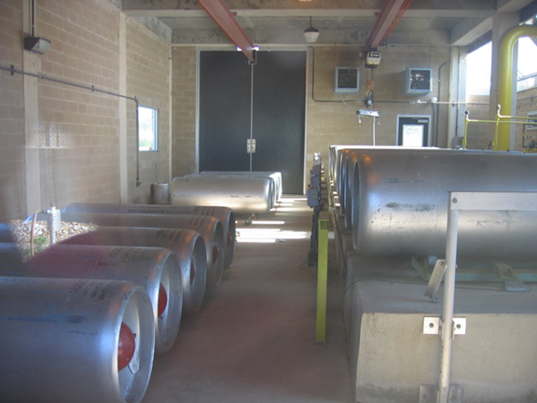
Chlorine Gas - 1 Ton Cylinders
Designed to lay on their sides during transportation, handling and use
Must be handled using a hoist, which is part of the specially built storage building.
Stored on trunnions and/or scales to prevent rolling around while allowing them to be rotated for proper valve positioning during connection.
Valves are protected by a bowl shaped-cover (bonnet) that attaches to the end of the container and should be secured and in place during transportation and handling of the ton cylinders.
Only remove covers to connect to the feed system.

Slide 11
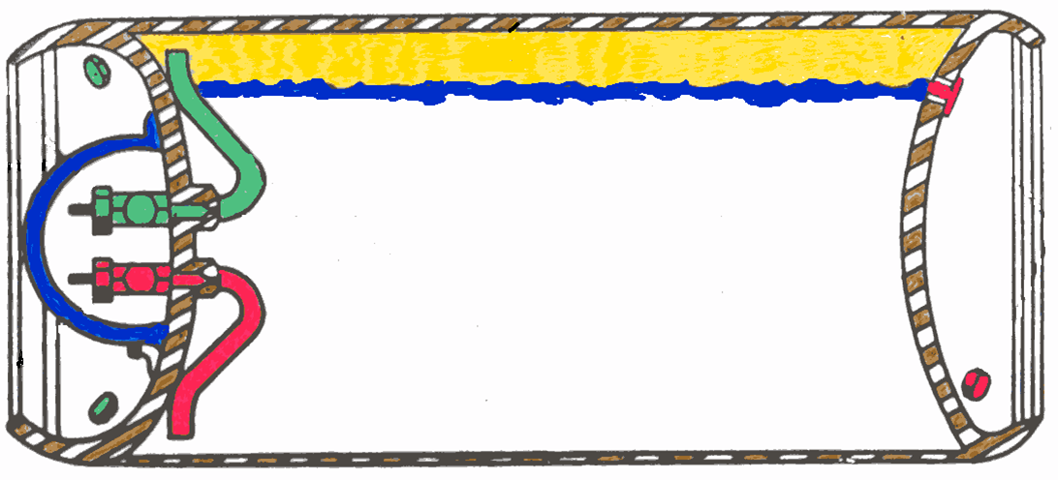
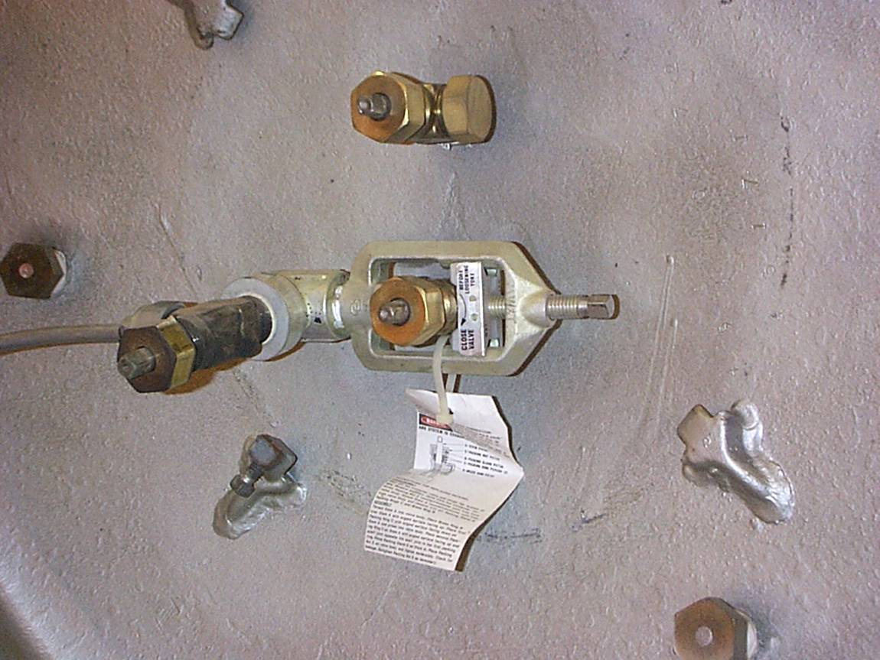
Chlorine Gas - 1 Ton Cylinders
Have two valves on the end, which allows for the feeding of either gas or liquid chlorine.
Top valve at the 12 o'clock position draws off chlorine gas
Bottom valve at the 6 o'clock position will feed liquid chlorine to an evaporator
Holds 2,000 lbs of chlorine, but weighs ~ 3,700 lbs when full.
Can deliver 400 lbs/day/cylinder without any trouble.
Above that feed rate, frosting and freezing will occur.
When feeding chlorine as a liquid, the withdrawal rate is much higher at 9,600 lbs/day/cylinder when using an evaporator.

Slide 12
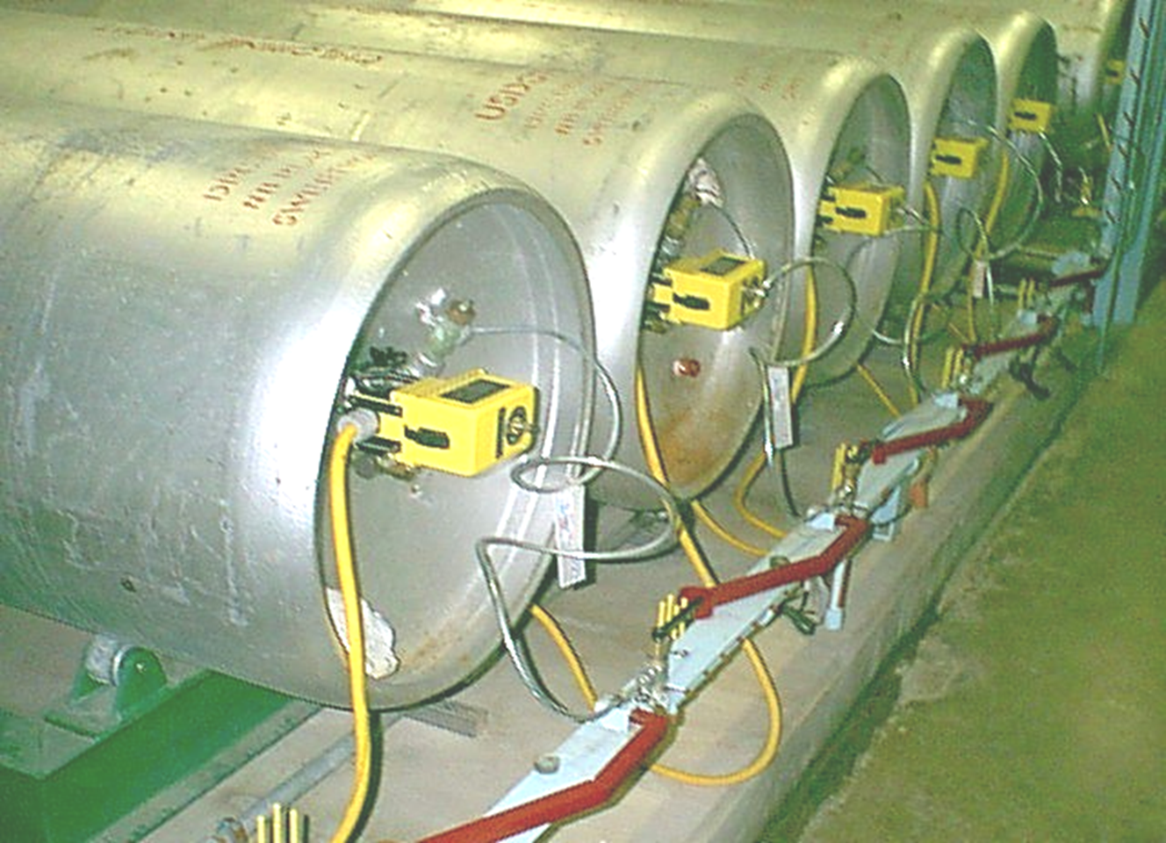
Chlorine Gas 1 Ton Cylinders
Every gas cylinder will have 6 (three on each end) “fusible plugs” that is designed to melt at 157°F.
Room temperature to be kept between 60°F and 120°F.
Room must be clean and dry
Reacts violently with:
  grease,
  turpentine,
  ammonia,
  hydrocarbons,
  metal filings.
Do not use organic solvents or greases on equipment
Only use wrenches made for these valves
Never reuse washers

Slide 13
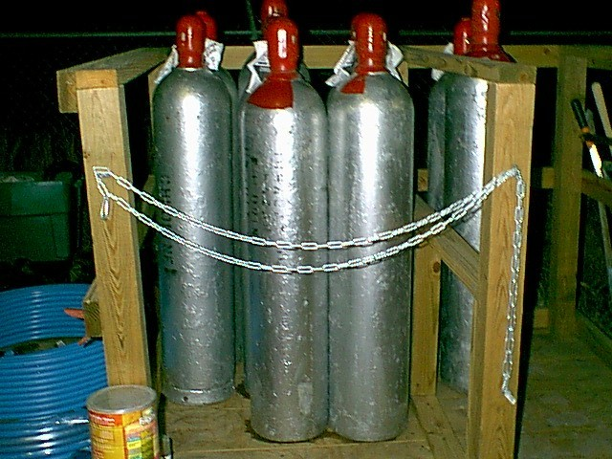
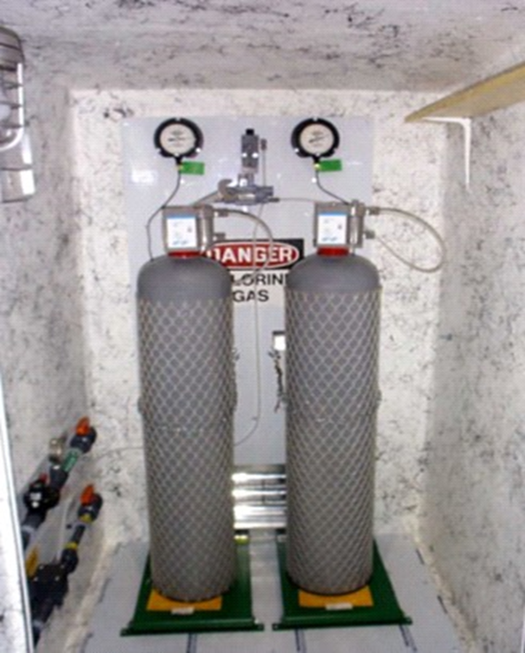
Chlorine Gas - 150 lbs Cylinders
Stored in the upright position and secured by chains.
Total weight of a 150 lb-cylinder is about 285 pounds.
Ensure valve is not damaged when handling the cylinder.
Protective hood stays in place to protect the valve.
Special dollies with safety chains for transporting chlorine cylinders.
Feed rate is limited to 40-42 lbs/day
One safety plug in valve
Do not expose to direct sunlight
Other rules for 1-Ton apply

Slide 14
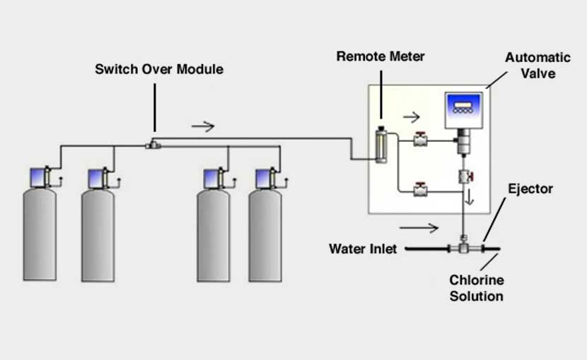
Chlorine Gas Flow
Effluent
Contact Chamber
Influent

Slide 15
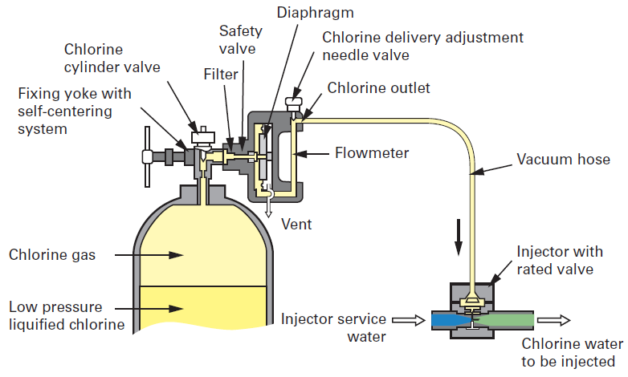
Chlorine Gas Flow
Effluent
Contact Chamber
Influent

Slide 16
Hypochlorination

Slide 17
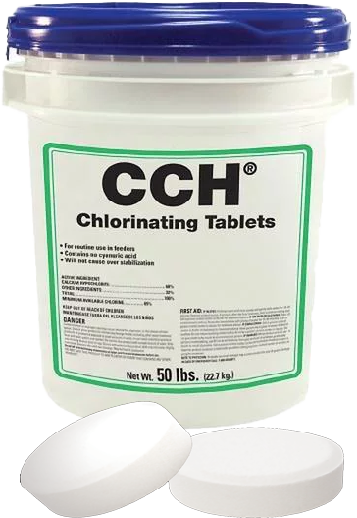
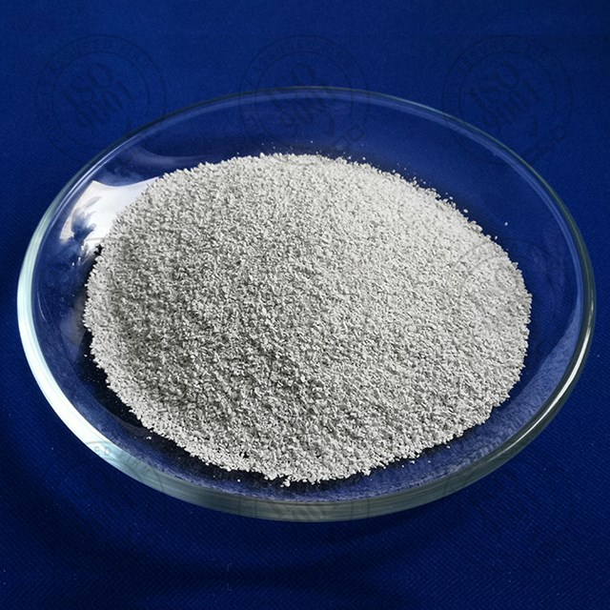
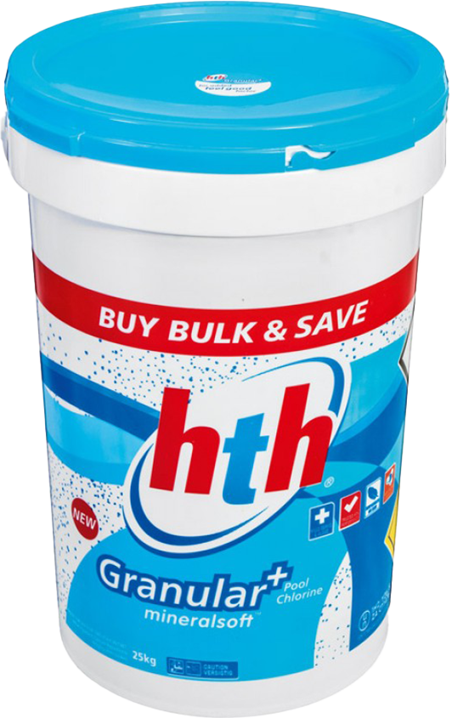

Chlorine Solids
Tablet or granulated powder
  HTH or High-Test Hypochlorite, OCl⁻ , ClO⁻
  Calcium Hypochlorite most common, Ca(ClO)₂
  Pure - 99.2% available chlorine
  65-70% available chlorine most widely used
  2-3 times more expensive, per pound of chlorine, than chlorine gas
Properties
  White, yellow or blue-speckled powder or tablet
  Strong Oxidizer (do NOT store with hydrocarbons)
  Corrosive, especially to metals and clothing

Slide 18
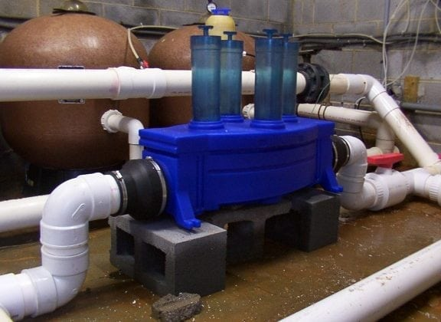
Chlorine Powder & Tablet Feed Systems
Must be turned into liquid and stored by dissolving into a liquid solution before feeding
Storage only good for 30 days
For small systems <500,000 gpd
Can be used for algae and odor control
More aptly to be used to disinfect treatment units, storage tanks, & wells
Commonly used where gas systems are impractical
Requires proper mixing, solution tanks, and feed pumps
Solid chlorine is a strong oxidizer

Slide 19
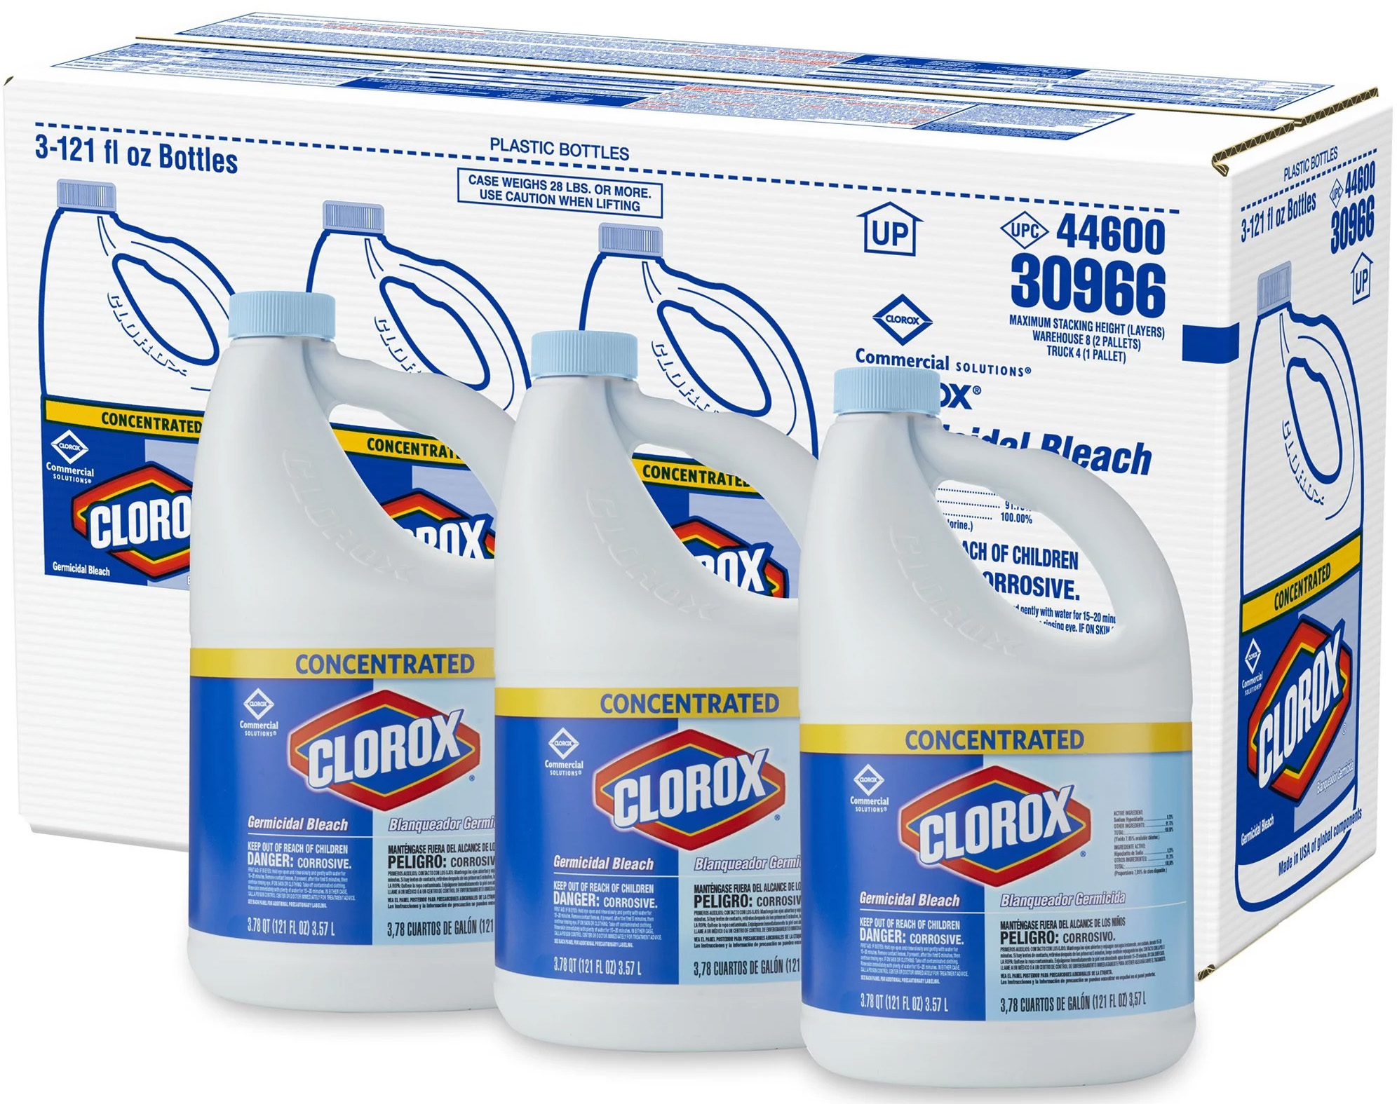
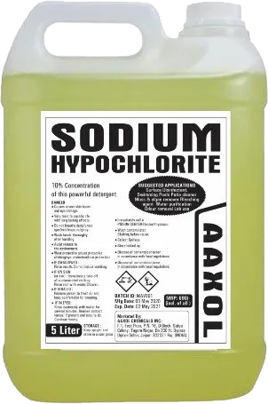
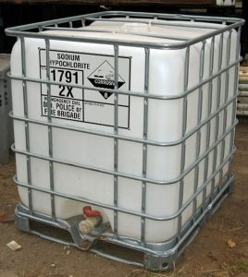
Liquid Chlorine
Sodium Hypochlorite most common, NaOCl or NaClO, some Calcium Hypochlorite used
Totes, Barrels, Bottles, Tankers
Household bleach is 5.25% available chlorine
Commercial and Industrial strength chlorine is 12-15%
Most costly per pound of available options
Clear to yellow color
Corrosive, irritant, toxic
Can lose up to 4% of its available chlorine content per month
Should not be stored for more than 60 to 90 days
Will leave calcium, magnesium or sodium salts/carbonates behind

Slide 20
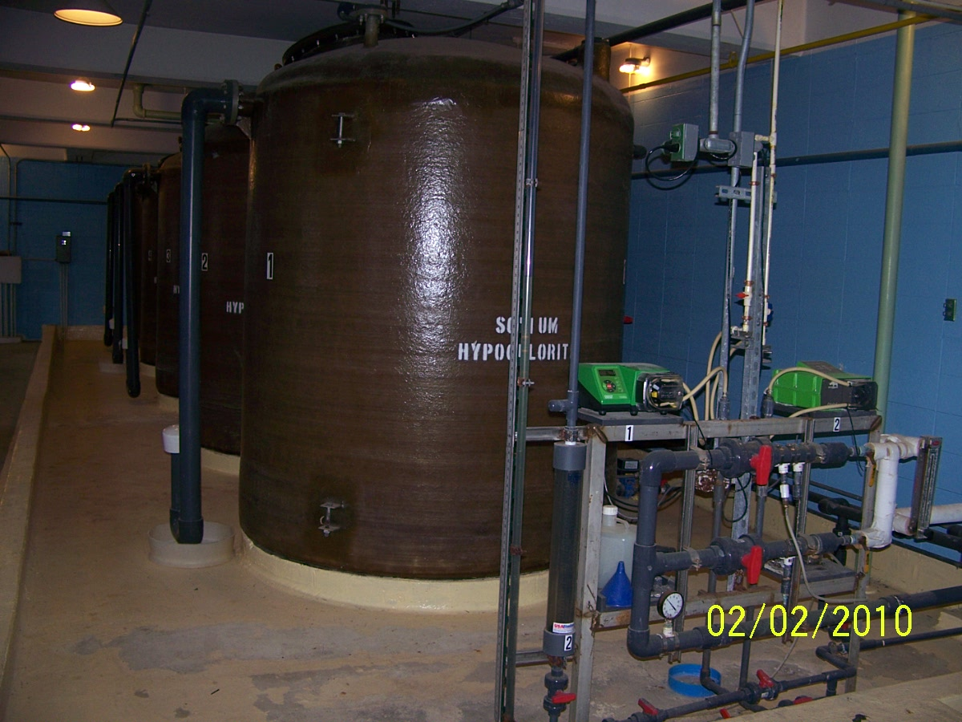
Sodium Hypochlorite Feed System

Slide 21
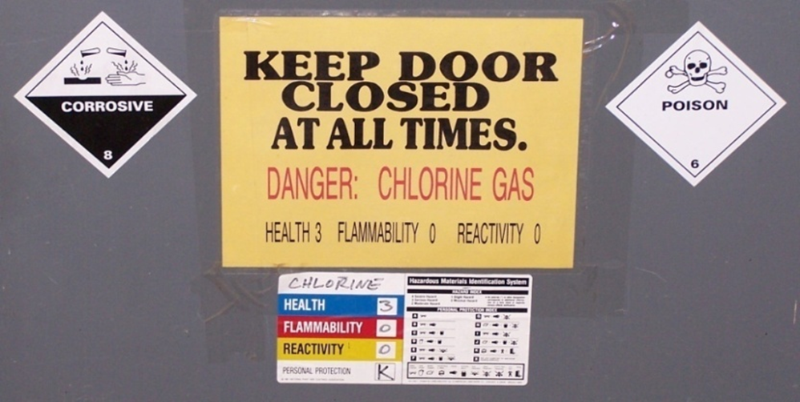

Chlorine Safety
Use buddy system
Storage and cylinder room should be separate from feeding room
Building requires ventilation and scrubber
PPE
  Goggles and/or Face Shield
  Chemical Resistant Gloves
  Chemical Apron
  Escape or cartridge respirator
  SCBA

Slide 22

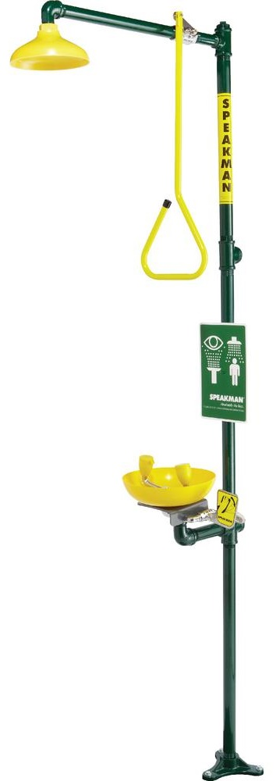
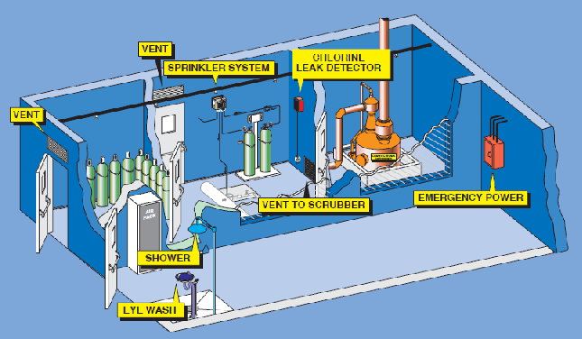
Chlorine Safety
Requires both Hazard Assessment and Emergency Preparedness Plan
Chlorine detector
Ventilation & light switches, detector readout and warning lights on outside of building
Safety Shower nearby
Eye wash station nearby
Leak detection kit
Emergency Repair kits

Slide 23
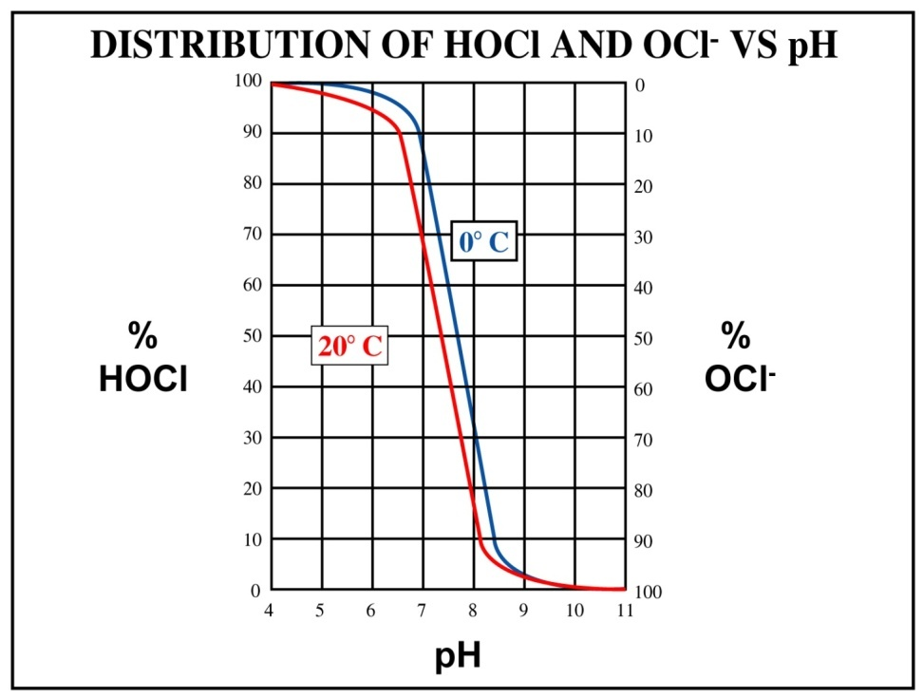
Chemistry of Chlorine
Hydrolysis occurs when chlorine (Cl₂) reacts with water (H₂O) producing:
  Hypochlorous acid (HOCl) and
  Hydrochloric acid (HCl)
Reaction with water
Cl₂ + H₂O " HOCl (Hypochlorous) + HCl (Hydrochloric)
Which breaks down further
  H⁺ (Hydrogen ions) + OCl⁻ (hypochlorite ions) + Cl⁻ (Chlorine ions)
Reacts with reducing compounds, such as organic matter and inorganic contaminants (iron, manganese, H₂S, & ammonia)
Uses the chlorine concentration available until all compounds have been destroyed by the chlorine
Once reducing agents in the wastewater have been destroyed, chlorine residual begins to accumulate
Chlorine concentration (C) and contact time (T) impact the disinfection process the most

Slide 24
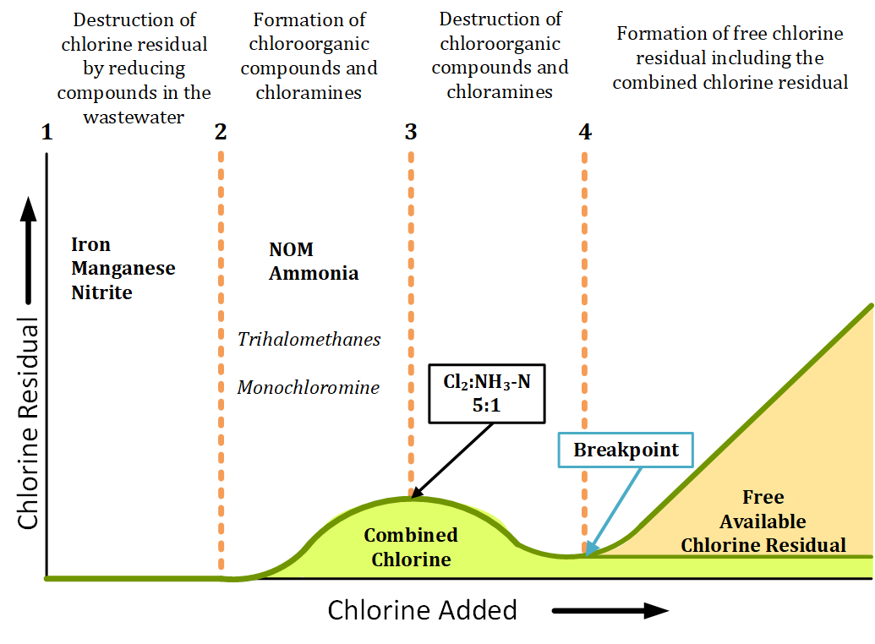
Breakpoint Chlorine
Notes:
NOM - Natural Organic Matter
Between points 1 and 2 on the breakpoint curve above is where the chlorine demand occurs.
Between points 2 and 3 on the curve, the organic compounds and ammonia react with the chlorine, creating
chloroorganic compounds, such as trihalomethanes (THMs) and chloramines, such as monochloramine. This
reaction will peak at a ratio of 5:1 (Cl₂:NH₃-N).
Between points 3 and 4, a reduction in chlorine residual occurs until all the chloroorganic and ammonia are oxidized.
Point 4, where the curve bottoms out, is known as the breakpoint. Any chlorine added after breakpoint occurs creates a free available chlorine residual that will increase at a linear pace. The free chlorine residual also includes the combined chlorine residual.

Slide 25
Chlorine Dosage = Demand + Residual
Chlorine demand is the difference between the amount of chlorine added to the water and the amount of residual chlorine remaining after a given contact time.
  Demand may change with dosage, time, temperature, pH, and the nature and amount of the impurities within the water.
Chlorine residual is the concentration of chlorine present in the water after the demand has been satisfied.
  Expressed in terms of the total chlorine residual (TCR), which includes both the free and combined (chemically bound) chlorine residuals.
Combined, or chemically bound, chlorine residuals are composed of:
  Free chlorine
  Ammonia
    Reacts with hypochlorous acid to form the Chloramines
  Chloramines
    Monochloramine, NH₂Cl
    Dichloramine, NHCl₂ - best disinfectant
    Trichloramine, NCl₃
Chlorine dosage is the amount of chlorine added to the water.
  Measured in mg/L
  Density, specific gravity and percent available chlorine must be taken into consideration.
  Remember: 1% = 10,000 mg/L (ppm)

Slide 26
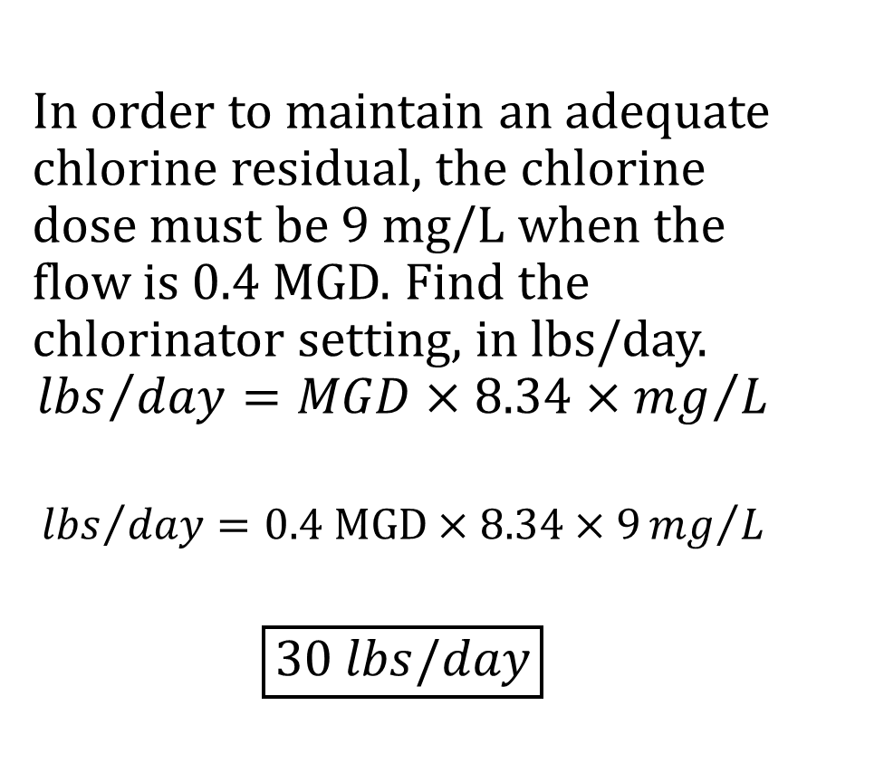
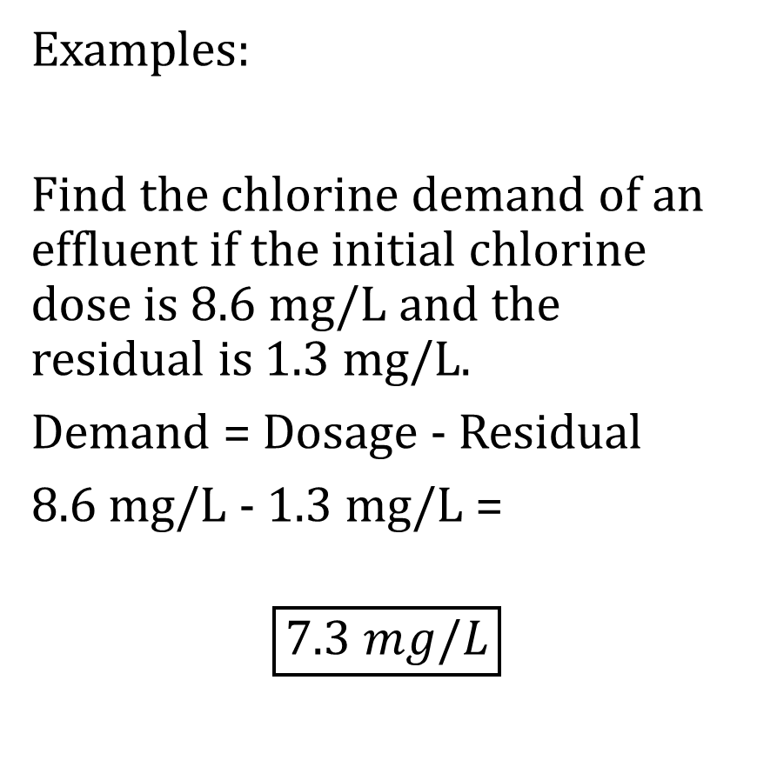
Chlorine Dosage = Demand + Residual
Examples:
Find the chlorine demand of an effluent if the initial chlorine dose is 8.6 mg/L and the residual is 1.3 mg/L.
Demand = Dosage - Residual
8.6 mg/L - 1.3 mg/L =
$$\boxed{7.3 mg/L}$$
In order to maintain an adequate chlorine residual, the chlorine dose must be 9 mg/L when the flow is 0.4 MGD. Find the chlorinator setting, in lbs/day.
$${lbs}/{day}=MGD×8.34×{mg}/L$$
$${lbs}/{day}=0.4 MGD×8.34×9{mg}/L$$
$$\boxed{30 lbs/day}$$

Slide 27
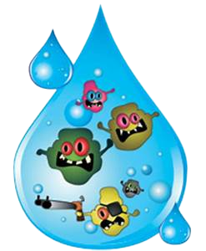
Chlorine
Factors Affecting Disinfection:
  Chlorine concentration (C)
    ↓ concentrations ↑ contact time
  Contact time (T)
    ↓ contact time ↑ dose
    Varies from state to state, but it is generally 15 minutes of CT at peak hour design flow or 30 minutes of CT at average daily design flow
  Water temperature
    ↓ temperature ↓ process slows, but is more stable; more time but not necessarily more concentration
    ↑ temperature ↑ process increases, residual dissipates more rapidly ↑ concentration
  Water pH
    ↓ pH, more hypochlorous formation better disinfection when using gas
    ↑ pH, more chlorite formation when using NaOCl and actually raises pH
  Foreign substances in the water
    Only effective if it is able to come into contact with the microbe it is
      intended to kill
    Any impurities in the water can shield the microbe from the chlorine

Slide 28
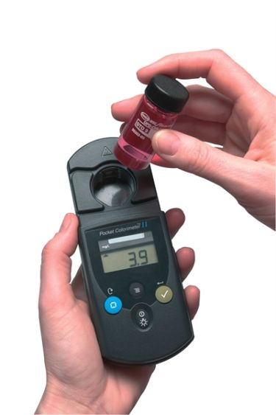
Chlorine Measurement
Total Residual Chlorine (TRC) = Free Chlorine (FCR) + Combined Chlorine (CCR)
Colorimetric test as Free or Total chlorine in mg/L
Testing must begin within 15 min of sampling
2 Methods are Amperometric Titration and Colorimetric DPD
Amperometric Titration
  Mainly used in laboratories
  Equipment costs and training prohibitive
  H₂S and methane will interfere
N,N-diethyl-p-phenylenediamine, DPD
  Most commonly used
  Turns shades of light pink to magenta (dark red/purple)
    Flash of dark color to clear may mean extreme residual
      > 5 mg/L
  Must perform calibration check prior to sampling
  every day before 1st use
  Uses 'blank' to allow for turbidity when using
    spectrograph equipment

Slide 29
Ultraviolet UV

Slide 30
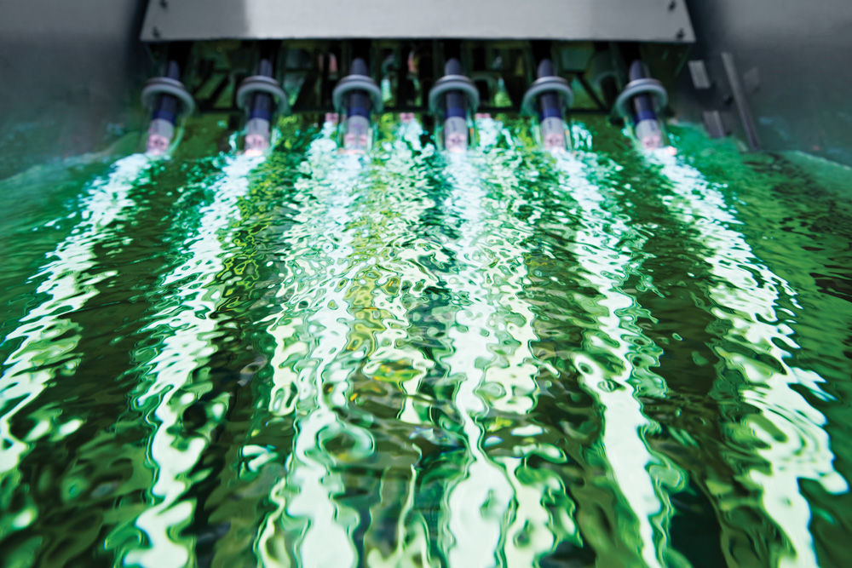
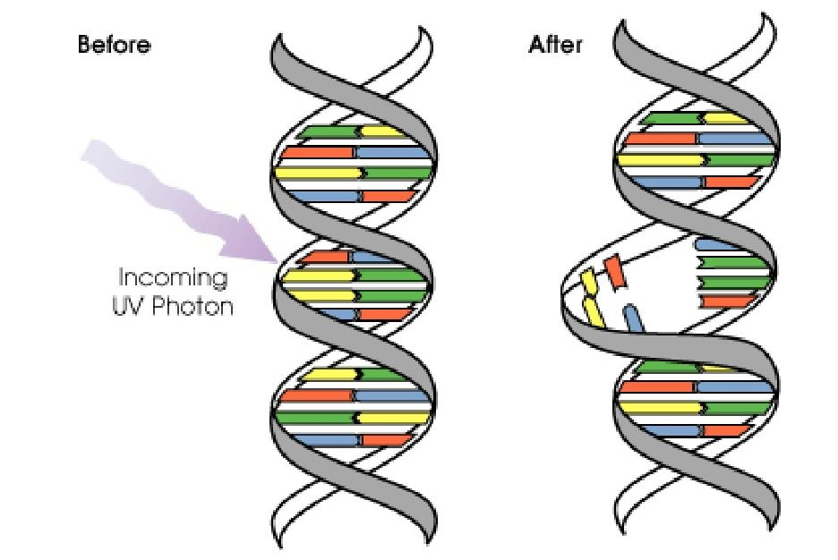
(Ultraviolet) UV Disinfection
Rapidly overtaking Chlorine as most common disinfection method until COVID
Closed Vessel or Open channel systems
Advantages
  Less safety hazard
  No harmful by-products
  Shorter contact time
  Uses less water than chlorine
Disadvantages
  Consumes more energy than chlorine
  Turbidity must remain low: TSS < 30 mg/L
  Aggressive maintenance program
  Requires back-up power source
Damages the DNA of the organisms
  no longer able to grow or reproduce
  Some organisms can 'repair' the damage after reentering sunlight

Slide 31
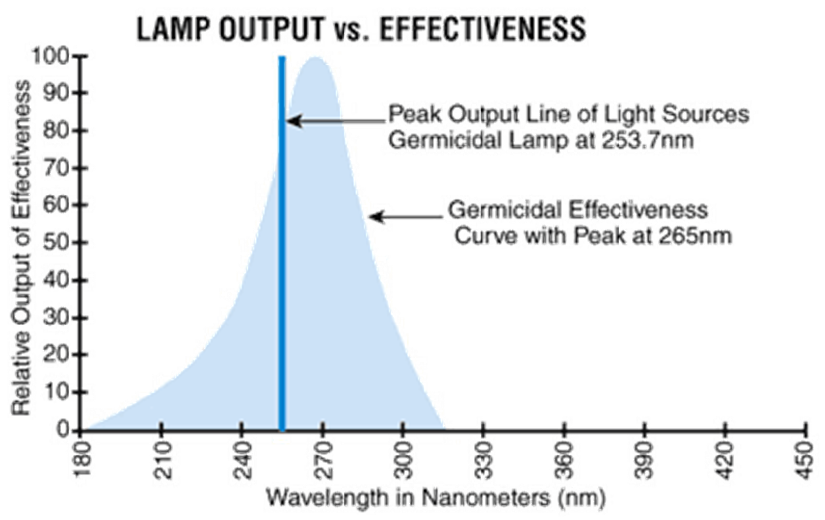
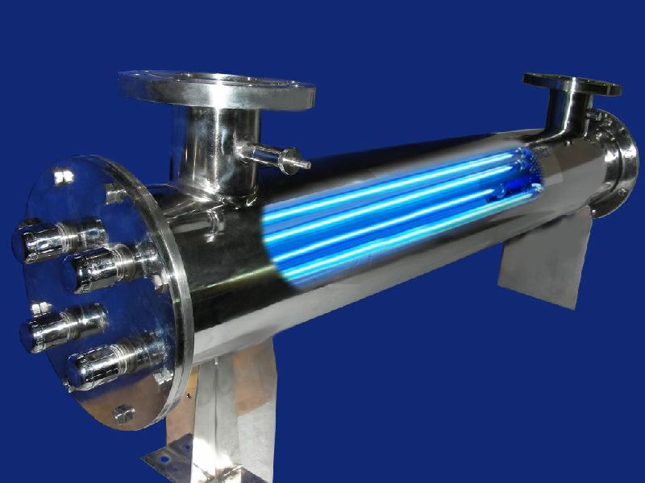
UV Disinfection
UV-C rays at 100–280 nm wavelength
UV radiation is generated by passing energy through mercury vapor
Low-pressure amalgam lamps produce light at 254 nm
Medium pressure lamps produce light at multiple wavelengths w/15-20x germicidal of LP
Optimum wavelength to effectively inactivate microorganisms = 250 - 270 nm
Flow must remain constant with little turbulence
Channel just wide enough to hold bank or series of banks

Slide 32
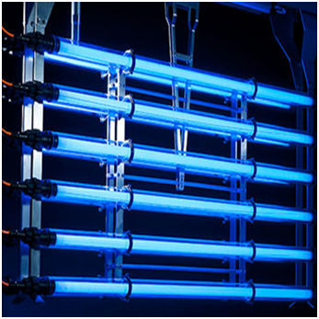
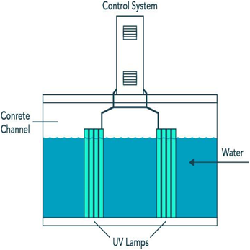
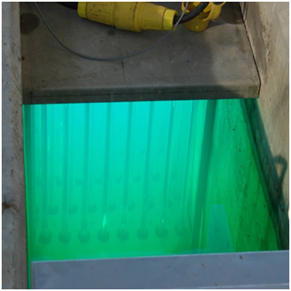
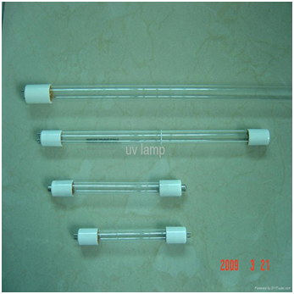
UV Disinfection
System referred to as 'contact reactor'
Low-pressure (LP) or medium-pressure bulbs (MP) enclosed in quartz cover for protection
Each bulb connected a ballast
Lifetime of bulb ~ 12,000 hours
Squeegees or wiper system to control build-up on quartz sleeves
Consists of multi-bulb 'rack' or module systems
Multiple modules forms banks
Racks either parallel (horizontally) or perpendicular (vertically) to water flow in channel
Flap gates, baffles, and weirs used to maintain constant water level & flow

Slide 33
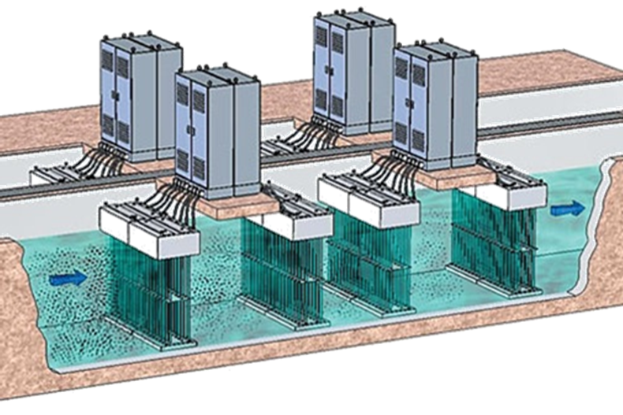
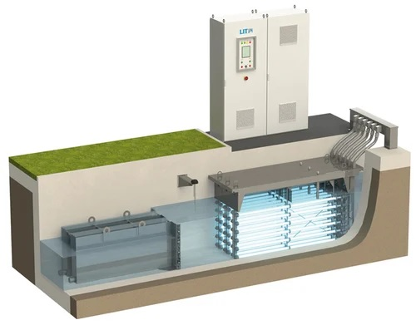
UV Disinfection
Light transmittance and intensity, flow, and turbidity measuring instruments required for process control
Monitor TSS with either in-line system or frequent testing
Ferric chloride for phosphorus removal cannot be used as it will 'stain' quartz sleeves
Systems with naturally hard water will need to be cleaned more frequently
Back-up generator required by EPA (make sure to test)
Coliform testing for effectiveness in CFUs/100 mL or MPN/100 mL

Slide 34
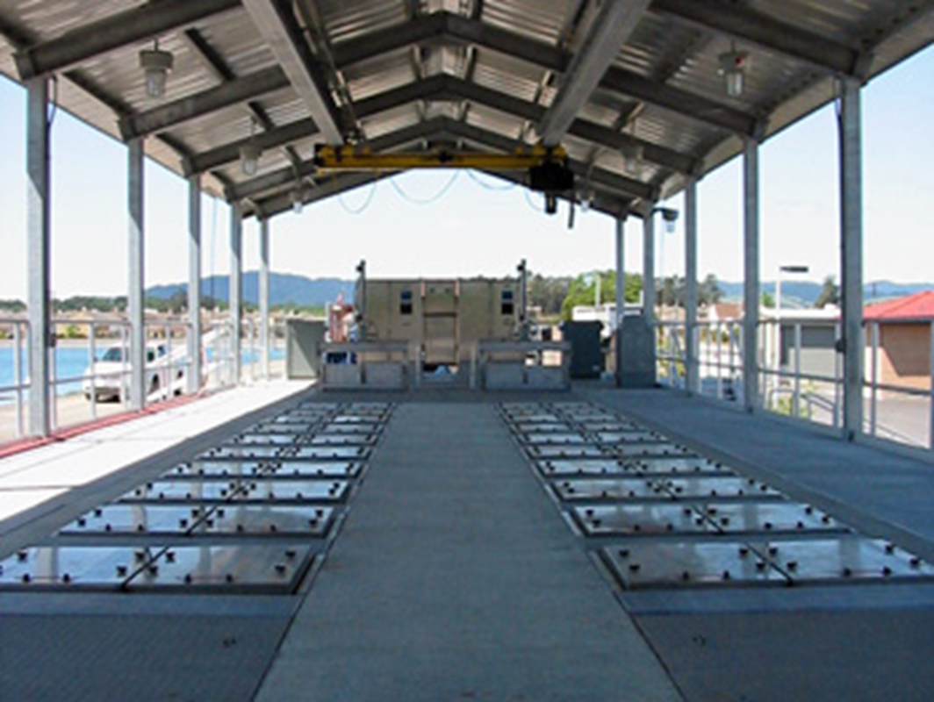
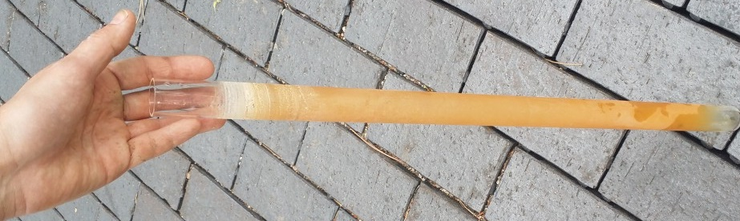
UV Disinfection OEM & PM
Bulbs, ballasts, and modules securely seated in channel or closed vessel with hatch closed before powering on
Replace bulbs and ballasts as they fail or reach maximum hours
Frequently monitor sensors and calibrate weekly
Keep reactor chamber/channel clean from algae and deposits
Inspect wiper/squeegee for proper operation and run times (manually run)
Clean quartz coverings as required with citric acid, CLR, phosphoric or other weak acid in dip bath with air scour
Yearly electrical inspection

Slide 35

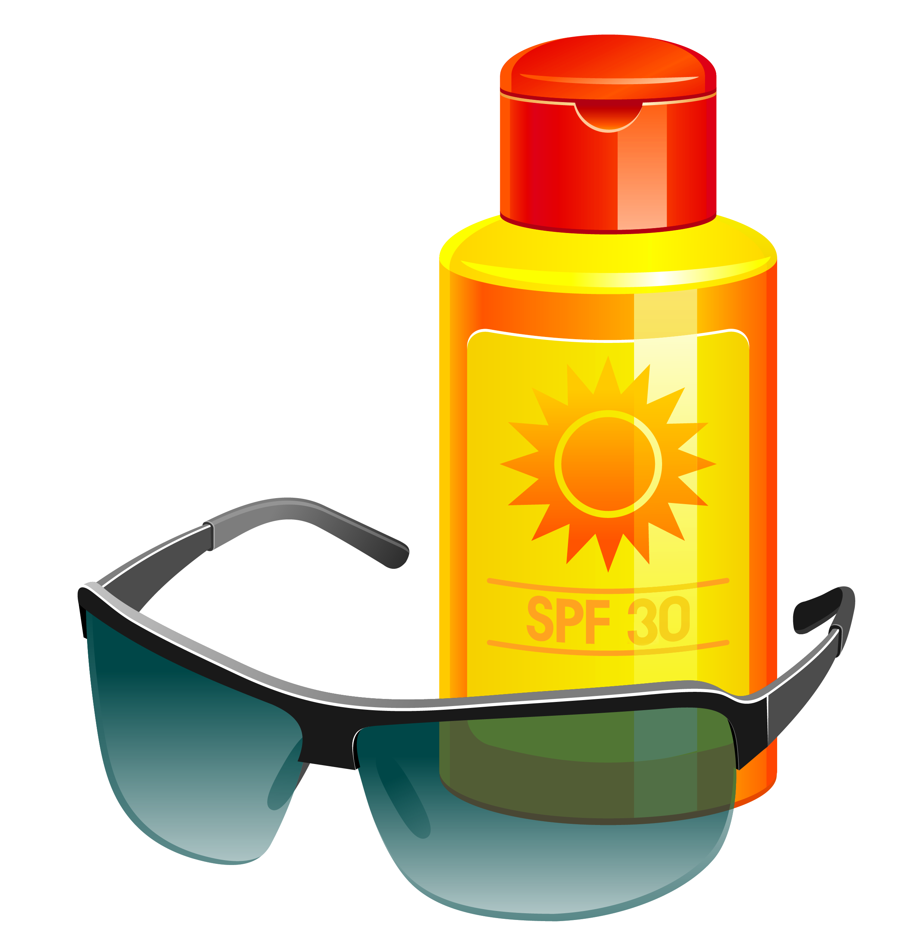
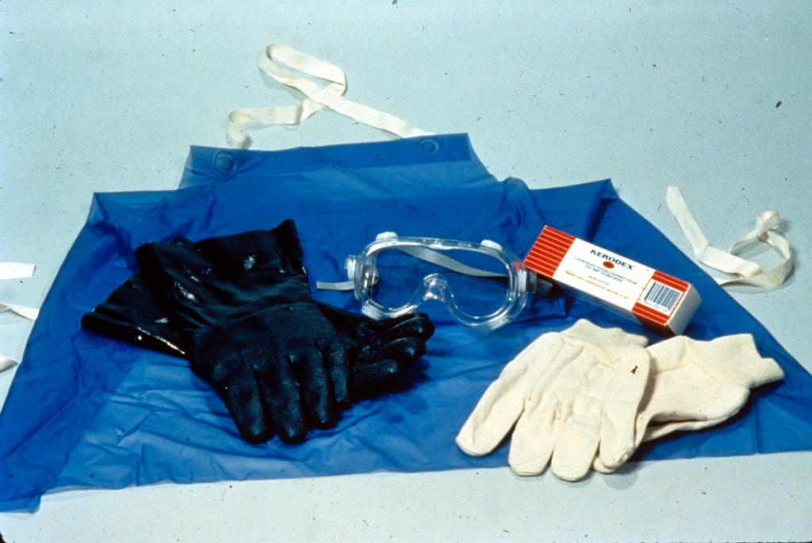
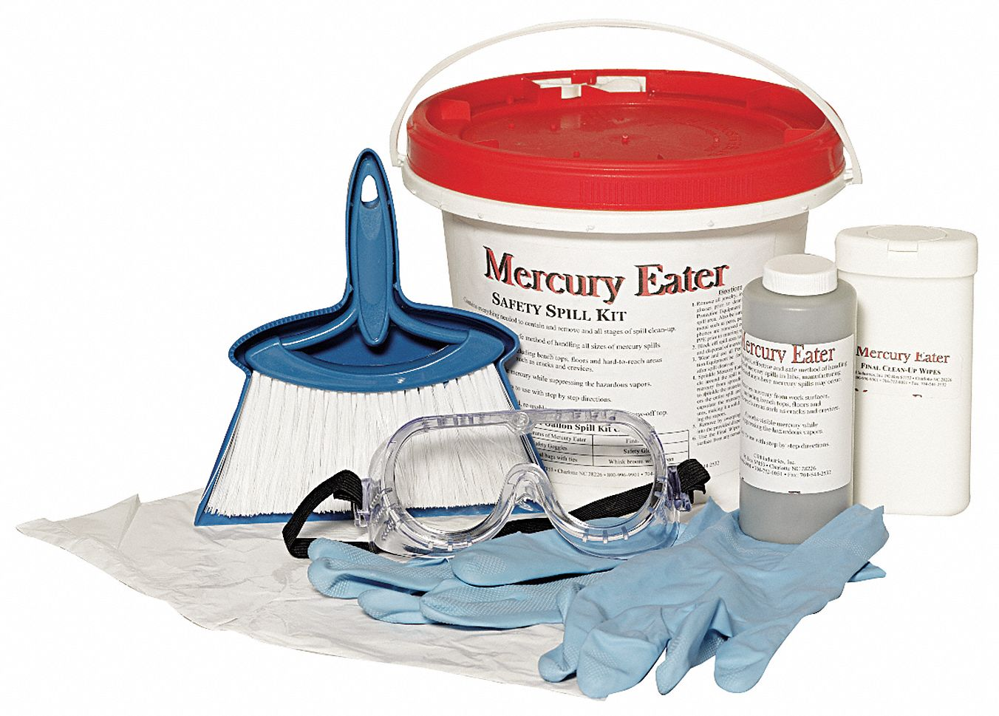
UV Disinfection Safety
Although sealed, water and electricity do not mix
  Lock Out/Tag Out when servicing!
Will cause 'sun burns'→ sunscreen or protective clothing
UV-C rated safety glasses/goggles/face-shield
  NEVER look directly at bulbs when powered on w/o eye protection
Contains mercury
  Mercury spill kit & PPE
Sharps disposal & PPE
Special disposal for used bulbs
PPE for chemical cleaning
PPE and safety procedures when cleaning channels

Slide 36
Dechlorination

Slide 37
Dechlorination
Free, uncombined chlorine is rarely found in wastewater due to characteristics of WW and chemical reactions
Must be performed before discharging to receiving waters
Commonly used methods are
  Granular Activated Carbon
  Agitation & Aeration in the form of step aeration or air diffusers
  Sunlight
  Sulfur Dioxide gas
  Sodium Salts used to form Sulfur Dioxide in solution
    Sodium Sulfite (Na₂SO₃ )
    Sodium Metabisulfite (Na₂S₂O₅ ) powder or a 38% aqueous solution
    Sodium Bisulfite (NaHSO₃ )
    Sodium Thiosulfate (Na₂S₂O₃ )

Slide 38
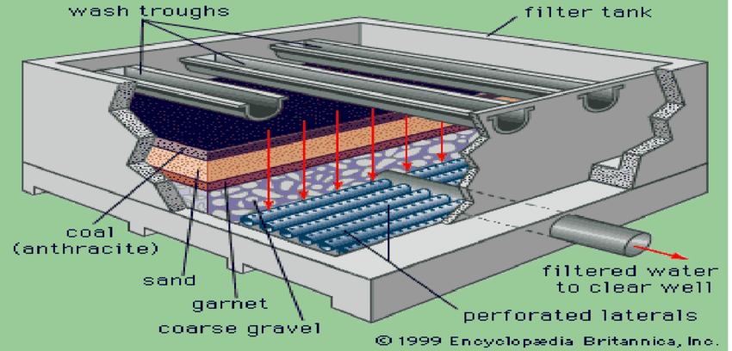
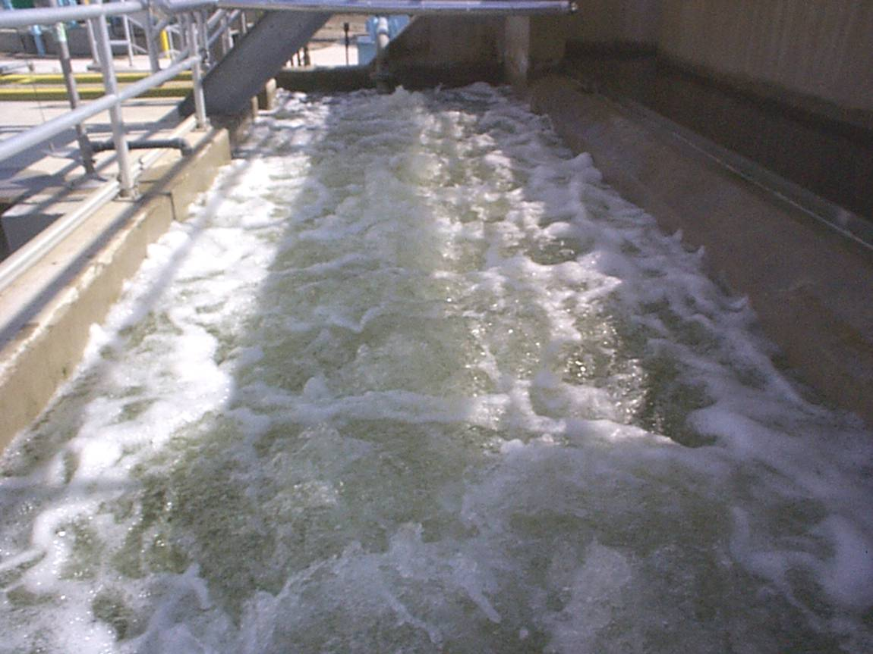
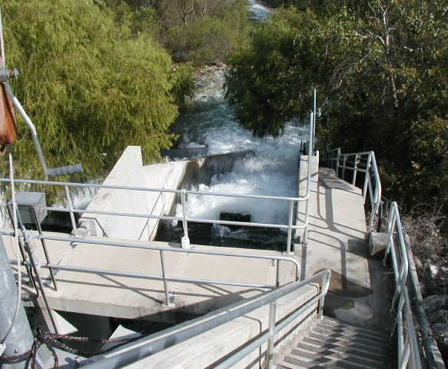
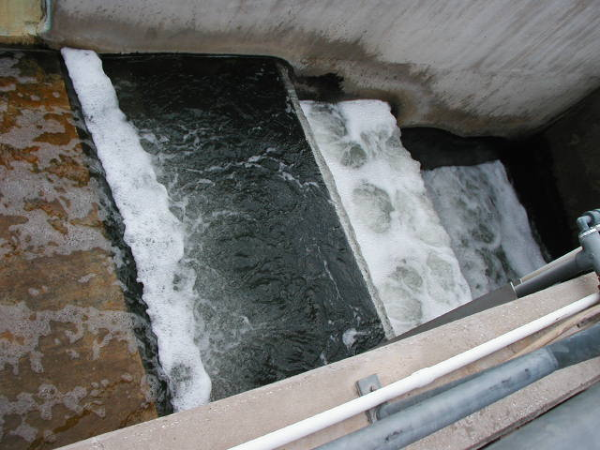
Natural Dechlorination
Requires long detention and contacts times
Granular Activated Carbon
  Part of tertiary treatment processes in rapid sand filters
Agitation & Aeration in the form of step aeration or air diffusers
  Added advantage of increasing DO
  Coarse bubble diffusers at end of contact chamber
Sunlight
  Must be shallow (inches) in depth
  Often combined with step aeration

Slide 39
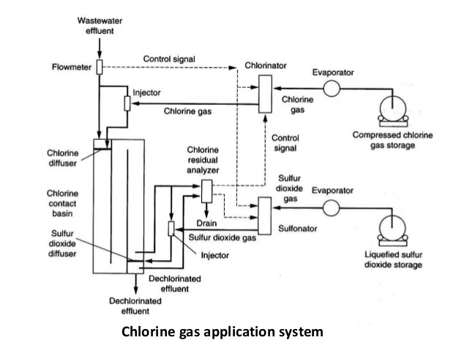
Chemical Dechlorination
Usually a 1:1 ratio
Faster reactions but prone to overdosing and more safety hazards
Overdosing
  Prevention
  pH lowered below 6.0-8.0 normal range
  DO lowered below minimum 4.0 mg/L
Sulfur Dioxide (SO₂):
  Most commonly used
  Non-flammable, colorless gas
  Pungent Odor
  Irritant & Corrosive
Sulfur dioxide gas (sulfonator) similar to chlorine gas (chlorinator) design and safety precautions

Slide 40
Chemical Feeders

Slide 41
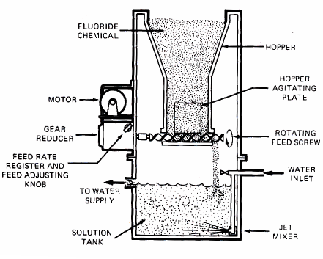
Chemical Feeders
Dry feeders (granular/powder)
  Volumetric dry feeders deliver a fixed volume of chemical per rotation of an auger, belt, or vibratory tray.
  Feed rate control: Adjust auger speed → changes volume delivered per unit time.
  Why operators use them: Provides consistent dosing even if chemical density changes (humidity, storage conditions).
  Common uses: Lime, polymer powders, soda ash, dry chlorine products.

Slide 42
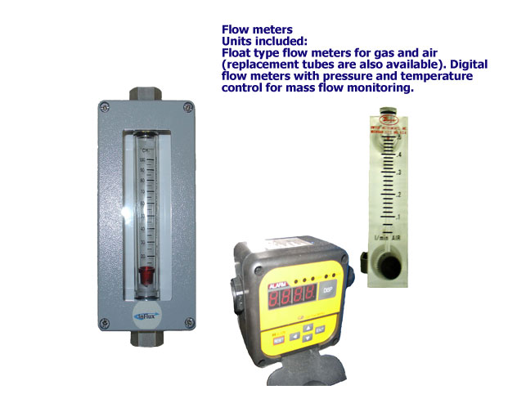
Chemical Feeders
Liquid feed pumps
(Bleach / Sodium Hypochlorite)
  Metering assemblies & venturi systems:
    Use vacuum to pull chemical from storage into the feed line.
    Provide steady, predictable dosing for hypochlorite solutions.
  Dosing pumps:
    Peristaltic
    Positive displacement
    Proportional feed pumps (flow‑paced)
  Storage options:
    Bulk tanks, shuttle tanks, totes, drums
  Backflow prevention:
    Spring‑loaded check valves, vacuum breakers
  Instrumentation:
    Rotameters for manual rate checks
    Control panels for automatic pacing (flow, residual, or time‑based)

Slide 43
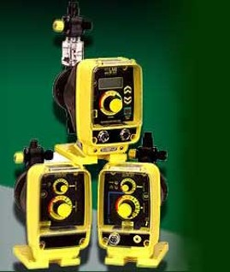
Chemical Feeders
Gas Feed Systems
(Chlorine, Sulfur Dioxide)
  Solution feed systems: Gas is pulled into a water stream to create a solution for dosing.
  Pump output control:
    Stroke length (how far the plunger moves)
    Stroke frequency (how fast it cycles)
  Control options:
    Manual
    Flow‑paced (adjusts feed rate based on plant flow)
  Pump types:
    Diaphragm
    Peristaltic
    Progressive cavity
  Operator note: Gas systems require leak checks, vacuum integrity, and emergency procedures.

Slide 44
Chemical Feeders (O&M)
Operation & Maintenance Requirements
Daily / Routine Tasks:
  Observe all operating components.
  Inspect suction and discharge lines.
  Check valves, diaphragms, rollers, fittings.
  Replace worn tubing immediately.
  Verify chemical strength (especially hypochlorite — it degrades).
  Clean tanks and day tanks regularly.
Calibration & Troubleshooting:
  Calibrate chemical metering pumps routinely or whenever performance seems off.
  Any leak in the system reduces chemical feed — repair immediately.
  If pump appears to run but feed rate drops → suspect ruptured diaphragm.
  Disassemble, clean, and inspect all wetted components per manufacturer recommendations.
Maintain spare parts inventory

Slide 45
Chemical Feeders (Safety & LOTO)
Follow full LOTO procedures before servicing pumps, tanks, or feed lines.
Maintain a spare parts inventory (tubing, diaphragms, rollers, check valves).
Wear appropriate PPE for the chemical being handled (chlorine, hypochlorite, polymer, acids).
Ensure chemical storage areas have ventilation, spill containment, and eyewash/shower access.
Document all maintenance and calibration activities.
Consult SDS and Hazardous Assessment and Emergency Procedures.
  Review the Safety Data Sheet (SDS) for every chemical used (hypochlorite, polymer, acids, lime).
  Complete hazard assessments before handling, mixing, or transferring chemicals.
  Follow site‑specific emergency procedures for spills, leaks, gas releases, or exposure.
  Ensure eyewash, shower, ventilation, and PPE are available and functional.
  Document all incidents and corrective actions.

Slide 46
Calculations for Solution Chemicals

Slide 47

Feed Pump Setting, % Stroke
Formula:
$$Feed Stroke \%=\left(\frac{Desired Flow, Q_{d}}{Maximum Flow, Q_{m}}\right)×100\%$$
The required chemical pumping rate has been calculated as 7.9 gpm. If the maximum pumping rate is 65 gpm, what should the percent stroke setting be?
? %Stroke; Q_{d}=7.9 gpm; Q_{m}=65 gpm
$$Feed Stroke \%=\left(\frac{Q_{d}}{Q_{m}}\right)×100\%$$
$$=\frac{7.9 }{65}×100\%=0.1215×100\%=\boxed{12.15\%}$$

Slide 48
Liquid Chemical Feed Pumps
To determine the settings for chemical feed pumps:
First, use the standard pounds formula to find how many “dry pounds” are needed to obtain desired dosage.
Then determine the "ml/min setting" for the feed pump.
lbs/gal = 8.34 x s.g. x decimal assay
gpd = lbs/day dry required ÷ lbs dry/gal
ml/min = (gpd x 3,785) ÷ 1,440
Example problem:
  Plant flow = 24MGD
  Alum dosage required = 18 mg/L
  Actual Alum assay = 48.9 % as Al₂(S0₄)₃
  Alum solution s.g. = 1.27 g/ml

Slide 49


Liquid Chemical Feed Pumps
Step One: Pounds @ 100%
24 MGD; 18 mg/L
Step Two: Pounds in 1 gal
48.9 %; 1.27 g/ml
$${lbs}/{day}=$$
$$MGD×8.34×{mg}/L$$
$${lbs}/{day}=$$
$$24×8.34×18=$$
$$\underline{3603 {lbs}/{day}}$$
$${lbs}/{gal}=$$
$$8.34×s.g.×decimal assay$$
$$decimal assay=\%÷100$$
$$=48.9÷100=0.489$$
$${lbs}/{gal}=$$
$$8.34×1.27×0.489=$$
$$\underline{5.179 {lbs}/{gal}}$$

Slide 50


Liquid Chemical Feed Pumps
Step Three: gpd to feed
3603 𝑙𝑏𝑠∕𝑑𝑎𝑦; 5.179 𝑙𝑏𝑠∕𝑔𝑎𝑙
Step Four: mL/min feed rate
3,785 mL/gal; 1440 min/day
$$gpd={lbs}/{day}÷{lbs}/{gal}$$
$$gpd=$$
$$3603 ÷5.179=$$
$$\underline{695.7 gpd}$$
$${mL}/{min}=$$
$$\left(gpd×3785 mL/gal\right)÷1440 {min}/{day}$$
$${mL}/{min}=$$
$$\left(695.7×3785\right)÷1440=$$
$$2,633,224.5÷1440=$$
$$\boxed{1828.6 {mL}/{min}}$$

Slide 51


Condensed Solution Formula
(ml/min)
$${mL}/{min}=$$
$$\frac{MGD ×{ mg}/L×2.628}{s.g. ×assay}$$
24 MGD; 18 mg/L; 48.9% as Al₂(SO₄)₃; 1.27 g/mL
$${mL}/{min}=$$
$$\frac{24 ×18×2.628}{1.27×0.489}=$$
$$\frac{1135 mL}{0.6210 min}=$$
$$\boxed{1827.6 {mL}/{min}}$$

Slide 52

Practical Application
A WWTP is treating a flow of 3.6 MGD. A 12% solution of Sodium Hypochlorite, having a s.g. of 1.18, is used for disinfection of this flow. A dosage of 4.4 mg/L will be applied. Find the mL/min feed pump setting:
? ml/min
3.6 MGD 12% Assay
1.18 s.g. 4.4 mg/L
$${mL}/{min}=$$
$$\frac{MGD ×{ mg}/L×2.628}{s.g. ×assay}$$
$${mL}/{min}=$$
$$\frac{3.6 ×4.4×2.628}{1.18×0.12}=$$
$$\frac{41.63 mL}{0.1416 min}=293.97 {mL}/{min}$$
$$\boxed{294.0 {mL}/{min}}$$

Slide 53
Calibration Of Dry Chemical Feeders

Slide 54

Dry Chemical Feeders
Dry chemical feeders (granular & powdered form) are calibrated to deliver in units of dry lbs/day.
Use the same pounds formula to determine the lbs/day requirement.
$${lbs}/{day}=MGD×8.34×{mg}/L$$
Procedure for calibrating a dry feeder:
Time how fast a bucket fills up (in minutes). Repeat at different settings (at least 5 times).
Weigh after each fill up and record in a chart. Calculate lbs/day.
Plot a calibration "curve" or line.
After plotting lbs/day at several settings, the calibration curve should form a straight line.
A straight line indicates the feeder is delivering chemical consistently.
Crooked or scattered line = feeder is not feeding uniformly
If the curve is not straight, adjust the auger, vibration, or feed mechanism per manufacturer instructions until linearity is achieved.
Most dry chemical feeders come with a manufacturer’s feed‑rate chart, and it usually shows something like:
  25 percent setting = X lbs/day
  50 percent setting = Y lbs/day
  75 percent setting = Z lbs/day
  100 percent setting = max lbs/day
Operators cannot trust that chart until you verify it with your own calibration

Slide 55
Dry Chemical Feeders
Worksheet
Calibration of Dry Feeders
Setting% | Time (t) | g caught | g/hr* | lbs/day*
100%
90%
80%
70%
60%
50%
40%
30%
20%
10%
*Notes: | g/hr = g caught x 60 ÷ t |  | lbs/day = g/hr x 24 ÷ 453.6

Slide 56
Dry Chemical Feeders

Slide 57
Practical Application
A dry Alum feeder was tested, and the following data collected:
  20% 480 g 3 min
  40% 1,000 g 3 min
  60% 1,490 g 3 min
  80% 1,980 g 3 min
  100% 2,470 g 3 min

Slide 58
Practical Application
Worksheet
Calibration of Dry Feeders
Setting% | Time (t) | g caught | g/hr | lbs/day
100% | 3 | 2470
80% | 3 | 1980
60% | 3 | 1490
40% | 3 | 1000
20% | 3 | 480

Slide 59

Practical Application
g/hr = g caught x 60 ÷ t
$$100\%=2470g×60 {min}/{hr}÷3 min=\boxed{49,400 g/{hr}}$$
$$80\%=1980g×60 {min}/{hr}÷3 min=\boxed{39,600 g/{hr}}$$
$$60\%=1490g×60 {min}/{hr}÷3 min=\boxed{29,800 g/{hr}}$$
$$40\%=1000g×60 {min}/{hr}÷3 min=\boxed{20,000 g/{hr}}$$
$$20\%=480g×60 {min}/{hr}÷3 min=\boxed{9,600 g/{hr}}$$

Slide 60
Practical Application
Worksheet
Calibration of Dry Feeders
Setting% | Time (t) | g caught | g/hr | lbs/day
100% | 3 | 2470 | 49,400
80% | 3 | 1980 | 39,600
60% | 3 | 1490 | 29,800
40% | 3 | 1000 | 20,000
20% | 3 | 480 | 9,600

Slide 61

Practical Application
lbs/day = g/hr x 24 hr/day ÷ 453.6 g/lb
$$100\%=49,400×24÷453.6=\boxed{2614 {lbs}/{day}}$$
$$80\%=39,600×24÷453.6=\boxed{2095{lbs}/{day}}$$
$$60\%=29,800×24÷453.6=\boxed{1577{lbs}/{day}}$$
$$40\%=20,000×24÷453.6=\boxed{1058{lbs}/{day}}$$
$$20\%=9,600×24÷453.6=\boxed{508{lbs}/{day}}$$

Slide 62
Practical Application
Worksheet
Calibration of Dry Feeders
Setting% | Time (t) | g caught | g/hr | lbs/day
100% | 3 | 2470 | 49,400 | 2614
80% | 3 | 1980 | 39,600 | 2095
60% | 3 | 1490 | 29,800 | 1577
40% | 3 | 1000 | 20,000 | 1058
20% | 3 | 480 | 9,600 | 508

Slide 63
Practical Application

Slide 64
Fecal Sampling & Compliance

Slide 65
Fecal Sampling & Compliance
Wastewater operators typically test for:
  Fecal Coliform
  E. Coli
  Sometimes Total Coliform depending on permit
These are indicators of fecal contamination and tell you how well your disinfection process is working.
Why Wastewater Systems Sample
  Verify effluent disinfection is effective
  Meet NPDES permit limits
  Protect receiving waters
  Detect treatment failures early
  Adjust chlorine/UV dosing
  This is compliance-driven, not distribution-driven.
Based on permit frequency, sampling is usually required:
  Daily
  Weekly
  Monthly
And also:
  SSOs (Sanitary Sewer Overflows)
  After major treatment upsets
  When chlorine residual drops
  When UV intensity drops
  When turbidity spikes
  When operators suspect contamination
Fecal Indicator Methods
  Membrane Filtration
  Multiple‑Tube Fermentation (MPN)
  Colilert / DST

Slide 66
Fecal Sampling & Compliance
This connects directly to:
Disinfection–Dechlorination
Mechanical Chemical Feeders
Too little chlorine → fecal fails
Too much chlorine → dechlorination problems → false fecal pass
Poor mixing → inconsistent results
Too many UV bulbs out → fecal fails
Turbidity too high or algae bloom in UV channel → fecal fails
Malfunctioning pumps →:
  Low chlorine → fecal violations
  Too much chlorine → dechlorination problems → false fecal pass
  Dechlorination too low → false fecal pass
Plugged lines → no feed → instant failure
Air in lines → inconsistent dosing
Clogged or ‘stuck’ rotometers

Slide 67



Membrane Filtration (MF)
What it is:
  A measured volume of water is passed through a 0.45‑micron membrane filter that traps bacteria.
How it works:
  Filter is placed on selective growth media
  Incubated at the required temperature
  Colonies grow directly on the membrane
  Operator counts colonies (CFU/100 mL)
Why operators need to know it:
  MF is fast, accurate, and widely used for wastewater effluent and drinking water compliance.

Slide 68

Multiple‑Tube Fermentation (MTF / MPN)
What it is:
  A statistical method using multiple tubes of growth media to estimate bacteria concentration.
How it works:
  Sample is added to lactose broth tubes
  Tubes incubate
  Gas production = positive
  Pattern of positives is compared to an MPN table
Why operators need to know it:
  MTF is older but still accepted by EPA and ABC. It’s used when water is turbid or has high solids.

Slide 69






Colilert / Defined Substrate Technology (DST)
What Colilert Is
  Colilert uses defined substrates that react with coliforms and E. coli, producing color and fluorescence in individual wells.
How It Works
  Add reagent to the sample
  Pour into a Quanti‑Tray
  Seal the tray
  Incubate for 24 hours
  Yellow wells = Total Coliform
  Fluorescent wells under UV = E. coli
  Count positive wells and compare to the MPN table printed on the tray
Why It’s Used
  Fast and Simple
  No membrane filters or multiple tubes
  Works well for both drinking water and wastewater effluent
  Approved by EPA for RTCR and NPDES fecal testing

Slide 70
Fecal Sampling Procedures
Grab samples ONLY
Collect post‑disinfection
  Sample after chlorine contact basin or after UV system, depending on plant design.
Sterile bottles with sodium thiosulfate
  Prefer presterilized, disposable Whirl-pak® bags if using MF method
  Sealed presterilized, disposable IDEXX/Colilert ™ bottles for DST method
Why Thiosulfate?
  Neutralizes chlorine so it doesn’t kill bacteria in the bottle
  Ensures accurate fecal count
Leave headspace
  Wastewater sampling DOES allow headspace.
  “No headspace” is a drinking water rule.
  Wastewater bottles are typically ¾ full.
Avoid contamination
  Gloves
  Don’t touch inside of bottle or lid
  Don’t sample from turbulent or splashing points
  Avoid solids or debris if possible
  Use a sampling pole if needed
Keep ≤ 10°C (on ice)
  Store on ice immediately
  Do not freeze
  Maintain temperature until delivery
  Samples that will take longer than 1 hour to analyze should be cooled to between 1˚ – 4˚ C on ice or in a refrigerator.
Label & Fill out Chain of Custody (CoC):
  Date
  Time
  Location (Sample point, effluent, post‑UV, post‑chlorination)
  Sampler initials
  Permit ID if required
Analyze within 6 hours

Slide 71
Common Sampling Mistakes
These are the ones that cause permit violations:
  Sampling too close to turbulence → solids get in the bottle
  Sampling before full contact time
  Forgetting thiosulfate bottles
  Using non-sterile bottles or reusing Whirl-pak® bags
  Letting samples warm up
  Not mixing the sample gently before pouring into lab containers
  Sampling during high chlorine demand events (storms, high flow)
  Not documenting chlorine residual at the time of sampling
  Not delivering to lab within 6 hours
What Happens When You Fail a Fecal Limit?
  Notify supervisor
  Check chlorine residual or UV intensity
  Inspect chlorine contact basin or UV channel
  Check flow rate (high flow reduces contact time)
  Check turbidity/solids
  Adjust chlorine feed or UV output
  Resample if allowed by permit

Slide 72
QR Code to download pdf handout for slides and practice exam.

